Slide 1

BALANCED GROUP WORK SYSTEM

Slide 2

TOPICS
THE SCENARIO
GROUP ROLES
PROBLEM STATEMENT
REALESTIC SOLUTION
IMPLEMENTATION PLAN
EXPECTED BENEFIT

Slide 3
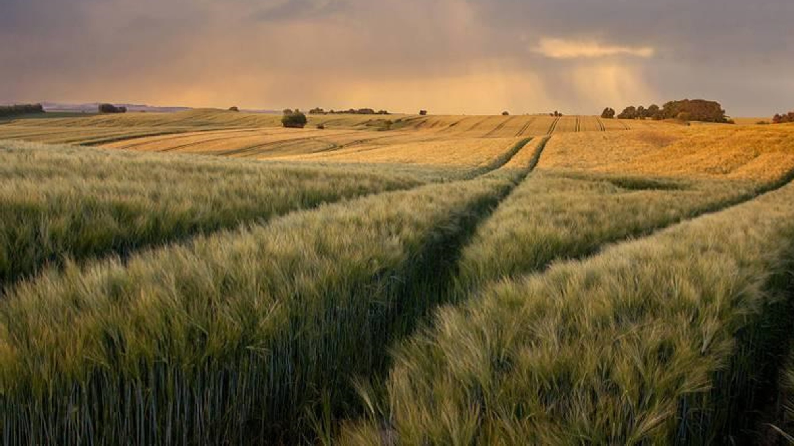
THE SCENARIO

Slide 4

The group consists of five members. Among them, two students handle the majority of the work, while one student attends meetings but remains silent. Another student relies on AI tools for all tasks without fully understanding the material, and the last student frequently misses meetings due to work commitments. our task is to design a fair group work system that ensures every member contributes appropriately.

Slide 5
RANKING ACCORDING TO THEIR POTENTIAL AND AVALIABILITY
MEMBER 1
8/10
MEMBER 4
6/10
MEMBER 5
MEMBER 3
MEMBER 2
8/10
3/10
LEADER
MAIN KID
5/10
AI KID
SILENT KID
LAZY KID
MOSTLY AVAILABLE
MOSTLY AVAILABLE
RELY MOSTLY ON AI
HARDLY ENGAGE WITH OTHER MEMBERS
MISSES THE MEETING MOST OF THE TIME

Slide 6
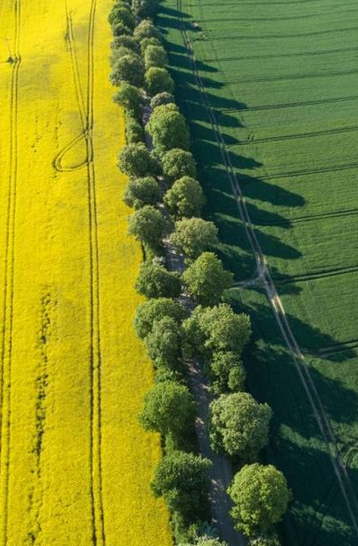
PROBLEM STATEMENT
COMPLICATED TO ASSIGN ROLES
NOT EVERYONE IS AVAILABLE
RELYING ON AI TOOLS
DON’T COMMUNICATE IN GROUPS

Slide 7
ASSIGNING ROLES
Role | What this person must do | Student name
Project Leader | Keeps the group focused and makes sure everyone contributes. | MEMBER 1
Discussion Manager | Asks questions and encourages quiet members to speak. | MEMBER 3,MEMBER 2
Writer/Designer | Writes the final group proposal neatly. | MEMBER 5, MEMBER 4
Presenter | Presents the group idea to the class. | MEMBER 2,MEMBER 1
Timekeeper | Controls the time and reminds the group of deadlines. | MEMBER 4, MEMBER 3

Slide 8
SOLUTIONS AND IMPLEMENTATION
ASSIGING ROLES
"Matching roles to team members based on their strengths and availability ensures that we maximize our potential and create a more dynamic work environment!"

Slide 9
SOLUTIONS AND IMPLEMENTATION
ORGANISING THE WORK BETWEEN EACH MEMBERS
We effectively divided the tasks among all members to ensure everyone contributes and succeeds together.

Slide 10
EXPECTED BENEFIT
THIS CAN IMPROVE FAIRNESS, COMMUNICATION, RESPONSIBILITY AND TEAMWORK BECAUSE EVERY MEMBER HAS THEIR VISIBLE TASKS AND ACCOUNTABILITY.

Slide 11
SOLUTIONS AND IMPLEMENTATION
ENCOURAGING EVERYONE TO WORK EQUALLY
Everyone brings a unique perspective to the table, and it’s essential for each voice to be heard. When we all contribute equally, we can truly enhance our situation and create a stronger outcome together. Let's collaborate and make our collective vision a reality!

Slide 12

Thank you
​

